Slide 1

Length of Stay in Hospitals
AnUrag dinesh KarmarkaR

Slide 2
Introduction
The problem focuses on the statistics of large and medium hospitals available with Australian Institute of Health and Welfare (AIHW).
The dataset is about the average length of stay of people in the hospitals.
The data can be used to derive a focused analysis based on what relation the hospitals' peer group has on the basis average length of stay in the hospital in terms of number of days.
The investigation of this data seeks to understand if there is any statistically significant difference in the average length of stay (ALOS) between large and medium hospitals which might make patients choose one over the other.

Slide 3
Problem Statement
The investigation of this data seeks to understand if there is any statistically significant difference in the average length of stay (ALOS) between large and medium hospitals which might make patients choose one over the other.
This investigation will make use of important statistical concepts like mean, standard deviation, variation, etc. to determine if there is a significant difference between the means of the ALOS for large and medium hospitals.
We will further use the null hypothesis testing for two independent samples to check if there is a difference between the means from the two categories.

Slide 4
Data Collection and Preparation
The data from Australian Institute of Health and Welfare (AIHW) was used for analysis of ALOS for the hospitals.
The data was prepared in the following steps : -
The data was imported into RStudio by skipping the first 12 lines. This was done because those lines contained the title and some explanatory notes.
The columns “Peer group” and “Average length of stay (days)” were renamed as “peer_group” and “alos_days” for ease in analysis.
The data from the columns “Peer group” and “Average length of stay (days)” was selected and stored in a different data frame “alos_data_filtered” for analysis.

Slide 5
Data Collection and Preparation
The ALOS column had non-numeric values such as ‘NP’ and ‘-’. ‘NP’ means reported data did not meet the criteria to calculate this indicator and ‘–’ means there were no patients reported for this indicator in this time period. Hence, we can ignore these values as they will not be of any importance in our analysis. The occurrence of these values is far too much for them to be replaced by the mean value and used in our analysis.
We only need the data for large and medium hospitals for this analysis. Hence the data was filtered and stored in the data frame alos_data_filtered2.
The data preparation was done, and the data frame also_data_filtered2 was used for analysis.

Slide 6
Code snippets for Data Preparation
#Rename Columns:-
names(average_length_of_stay_multilevel_data)[names(average_length_of_stay_multilevel_data) == "Peer group"] <- "peer_group“ names(average_length_of_stay_multilevel_data)[names(average_length_of_stay_multilevel_data) == "Average length of stay (days)"] <- "alos_days“
#Selecting the columns required for analysis:-
alos_data_filtered <- select(average_length_of_stay_multilevel_data,peer_group,alos_days)
#Deleting ALOS values with np and –
alos_data_filtered<-alos_data_filtered[!(alos_data_filtered$alos_days=="NP"),] alos_data_filtered<-alos_data_filtered[!(alos_data_filtered$alos_days=="-"),]
#Selecting the data for large and medium hospitals
alos_data_filtered2 <- alos_data_filtered[(alos_data_filtered$peer_group=="Large hospitals") | (alos_data_filtered$peer_group=="Medium hospitals"),]

Slide 7
Descriptive Statistics
The data for large and medium hospitals was summarised as follows,
alos_data_filtered2 %>% group_by(peer_group) %>% summarise(Min = min(alos_days,na.rm = TRUE),
Q1 = quantile(alos_days,probs = .25,na.rm = TRUE),
Median = median(alos_days, na.rm = TRUE),
Q3 = quantile(alos_days,probs = .75,na.rm = TRUE),
Max = max(alos_days,na.rm = TRUE),
Mean = mean(alos_days, na.rm = TRUE),
SD = sd(alos_days, na.rm = TRUE),
n = n(),
Missing = sum(is.na(alos_days)))
peer_group <chr> | Min <dbl> | Q1 <dbl> | Median <dbl> | Q3 <dbl> | Max <dbl> | Mean <dbl> | SD <dbl> | n <int> | Missing <int>
Large hospitals | 1.2 | 2.5 | 3.5 | 5.0 | 12.6 | 3.986874 | 1.978679 | 4411 | 0
Medium hospitals | 1.0 | 2.4 | 3.4 | 4.5 | 13.2 | 3.706049 | 1.852530 | 2182 | 0

Slide 8
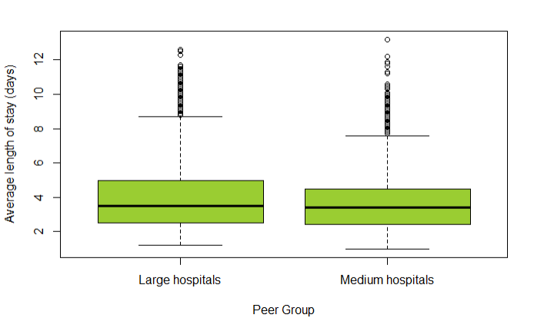
Visualisation (Box Plot)
The box plot showed considerable amount of mild outliners.
After looking at the data, it can be assumed that the values of the outliners are not data entry errors.
These outliners point out to the extended stays in the hospitals and hence are essential to the analysis of ALOS.
Hence the outliners were not ignored.
Code Snippet for Box plot :-
alos_data_filtered2 %>% boxplot(as.numeric(alos_days) ~ peer_group, data = .,col = "yellowgreen", ylab="Average length of stay (days)",xlab="Peer Group")

Slide 9
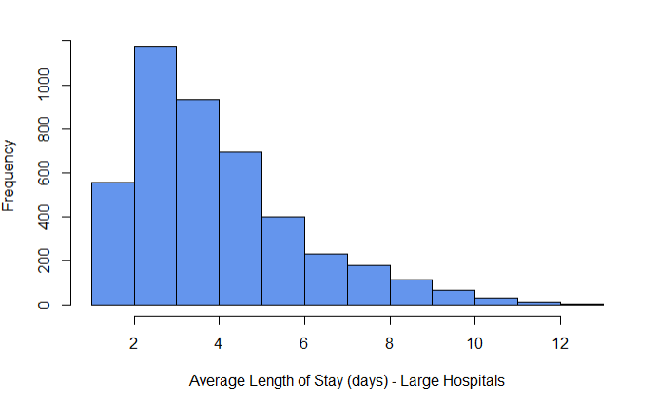
Histogram for AOLS for Large Hospitals
The figure shows that the histogram is right skewed and hence not normally distributed.
Code Snippet :-
alos_data_lh$alos_days %>% hist(xlab = "Average Length of Stay (days) - Large Hospitals",col = "cornflowerblue" , main = "")

Slide 10
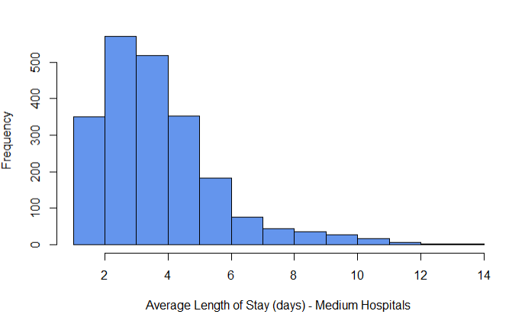
Histogram for AOLS for Medium Hospitals
The figure shows that the histogram is right skewed and hence not normally distributed.
Code Snippet :-
alos_data_mh$alos_days %>% hist(xlab = "Average Length of Stay (days) - Medium Hospitals",col = "cornflowerblue" , main = "")

Slide 11
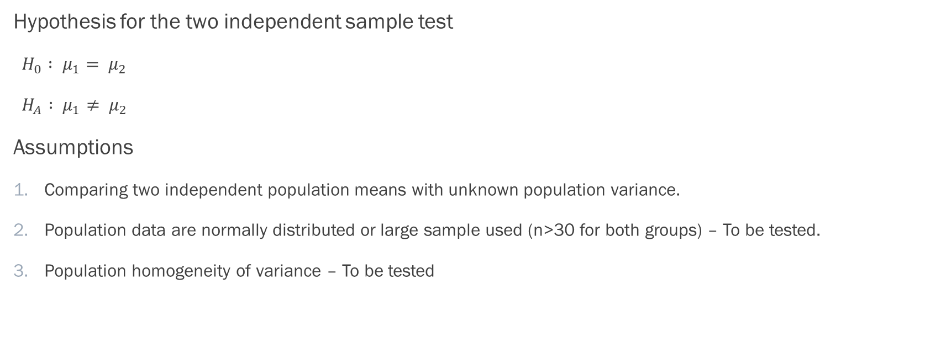
Hypothesis Testing
Hypothesis for the two independent sample test
$H_{0} : μ_{1}= μ_{2}$
$H_{A} : μ_{1}≠ μ_{2}$
Assumptions
Comparing two independent population means with unknown population variance.
Population data are normally distributed or large sample used (n>30 for both groups) – To be tested.
Population homogeneity of variance – To be tested

Slide 12
Hypothesis Testing
The dataset was divided into large and medium hospitals data separately and performed analysis for normalcy.
alos_data_lh <- alos_data_filtered2[alos_data_filtered2$peer_group %in% "Large hospitals",]
View(alos_data_lh)
alos_data_mh <- alos_data_filtered2[alos_data_filtered2$peer_group %in% "Medium hospitals",]
View(alos_data_mh)
Plot the Q-Q plot for analysis of normalcy
alos_data_lh$alos_days %>% qqPlot(dist="norm")
alos_data_mh$alos_days %>% qqPlot(dist="norm")

Slide 13
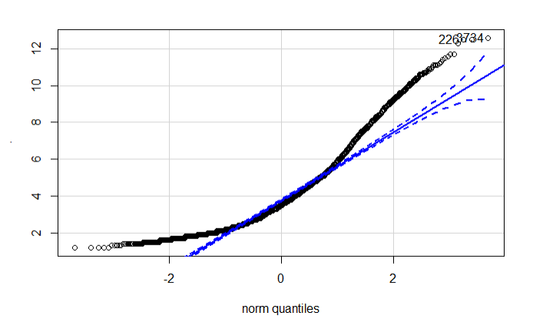
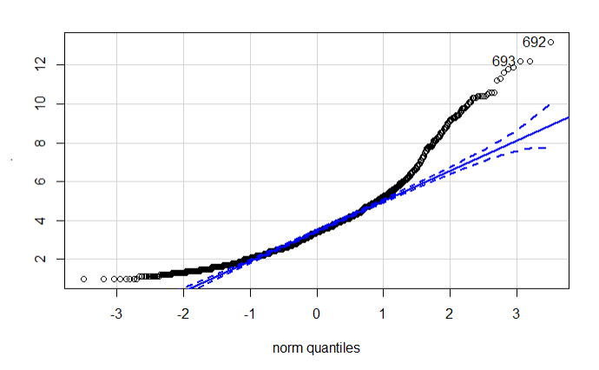
Q-Q Plots for ALOS
Large Hospitals
Medium hospitals

Slide 14
Hypothesis Testing
Many values are beyond the 95% Confidence Interval in large as well as medium hospitals, hence we cannot assume normalcy.
Thus the Assumption 2 was tested and it was found that the samples are not normally distributed.
However, due to a large number of sample size, normalcy was not a problem for the testing.

Slide 15

Hypothesis Testing – Levene’s Test
The third assumption was tested by using the Levene’s test for homogeneity in variance. The code snippet is as follows.
leveneTest(alos_days ~ peer_group, data = alos_data_filtered2)
Output
The probability value is 4.707e-05 which is less than 0.05.
Hence equal variance cannot be assumed.

Slide 16
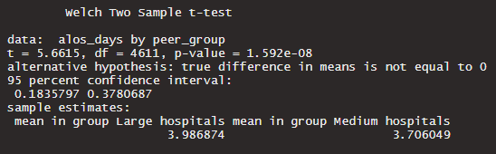
Hypothesis Testing – Welch Test
As Levene’s test for homogeneity in variance failed, we perform the Welch test with the following code snippet.
t.test(alos_days ~ peer_group, data = alos_data_filtered2,var.equal = FALSE, alternative = "two.sided")
Output

Slide 17
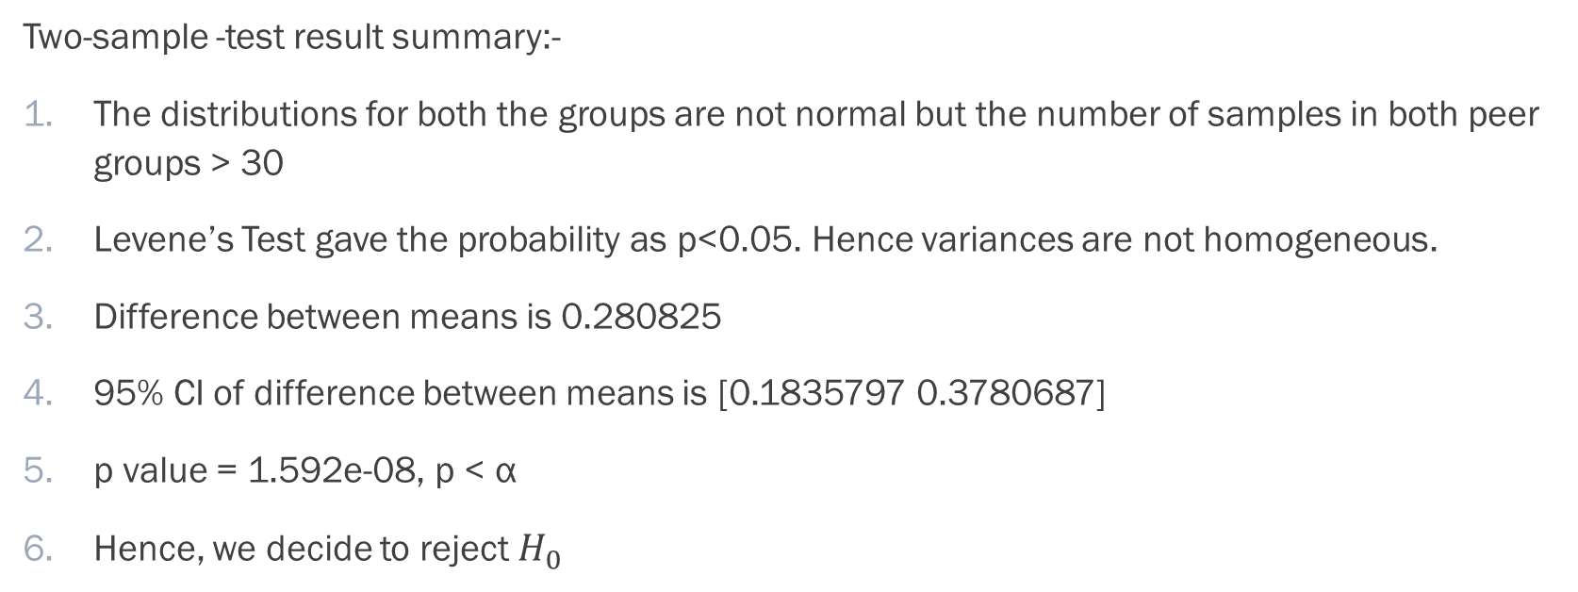
Test Results
Two-sample -test result summary:-
The distributions for both the groups are not normal but the number of samples in both peer groups > 30
Levene’s Test gave the probability as p<0.05. Hence variances are not homogeneous.
Difference between means is 0.280825
95% CI of difference between means is [0.1835797 0.3780687]
p value = 1.592e-08, p < α
Hence, we decide to reject $H_{0}$

Slide 18

Conclusion
The decision to reject $H_{0}$ means that the means are not equal.
The results of the study found a statistically signiﬁcant mean difference between large and medium hospitals, t(df=4611) = 5.6615, p=1.592e-08, 95% CI for the difference in means [0.1835797 0.3780687].

Slide 19
Discussion
It was found that the mean values average length of stay of the large and medium hospitals were significantly different.
The average length of stay for medium hospitals was less than that of large hospitals.
This delay in the length of stay might have also occurred as large hospital often take longer times to coordinate and process various doctors and patients.
This difference could have occurred due to the higher efficiency of the medium sized hospitals.
The large hospitals are less efficient in treating the patients as they require that the patients say a longer period of time.
The final insight that can be derived from this study is that one should visit a medium sized hospital over a large one to save time.
One could further investigate other hospital peer groups and their average length of stay or does average length of stay depend on other factors such as the local hospital network or the ailment for which they were treated, etc for further comparisons.

Slide 20
References
Average length of stay multilevel data - Australian Institute of Health and Welfare. 2020. Admitted Patients - Australian Institute Of Health And Welfare. [online] Available at: <https://www.aihw.gov.au/reports-data/myhospitals/sectors/admitted-patients#more-data> [Accessed 5 May 2020].
MATH1324 Introduction to Statistics Week 2 Demonstration - Introduction to R and RStudio
MATH1324 Introduction to Statistics Week 8 Demonstration - Testing the Null: Data on Trial - Two independent samples and Paired samples Inference

